Slide 1
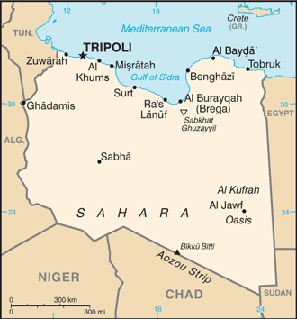
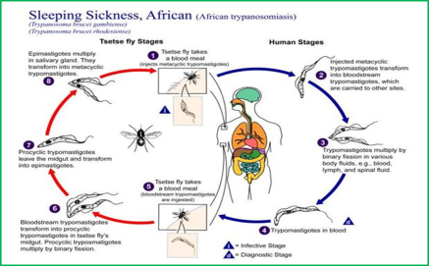
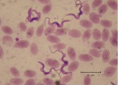
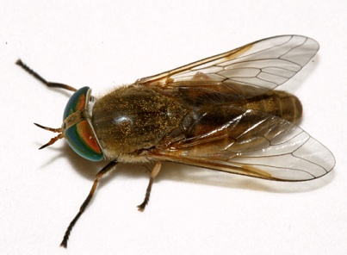
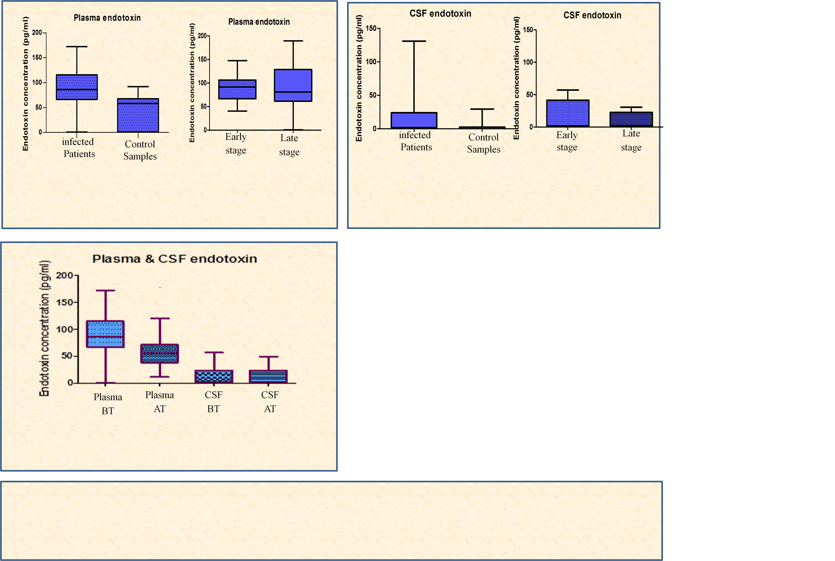
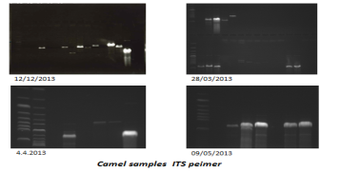
TRYPANOSOMIASIS
Endotoxin levels in plasmas and CSF patients infected with Trypanosoma brucei rhodesiense
Molecular markers for characterization of Trypanosomes
in camels in Sebha City - Libya
Eltayb A. M. Aboubaker* and Jeremy M. Sternberg**
r01eaa11@abdn.ac.uk & altib2002@yahoo.co.uk
**Institute of Biological and Environmental Sciences, University of Aberdeen - UK; *Faculty of Science, Sebha University – Libya.
Lipopolysaccharide (LPS)
Surra
The main source of endotoxin is gram negative bacteria in the gut.
Levels increased in the circulation during intestinal or hepatic
damage.
May be released from other concurrent bacterial infections when
organisms infect the body.
Endotoxin has been detected in infections with protozoa
pathogens such as African trypanosomes and malaria.
Can be liberated from the internal membranes of the trypanosome
and thus may be the cause of elevated endotoxin levels in this
infection.
Elevated level reported in the plasma of patients and experimental
mouse infected with T.b.gambiense .
Endotoxin has not been studied in T.b.rhodesiense infection.
Surra is a parasites disease of vertebrate animals such as horses,
donkeys, mules, cattle, buffalo, deer, camels, llamas, dogs, and cats.
Caused by protozoan trypanosomes, specifically Trypanosoma evansi.
Causing fever, weakness, and lethargy which lead to weight loss and
anemia. In some animals the disease is fatal unless treated.
Transmitted mechanically by species of Tabanus flies.
This disease occurs in South America, Northern Africa, and the
Middle East.
Diagnosis of the disease can be by using conventional techniques such
as wet blood film, The Haematocrit Centrifugation Technique (HCT),
Buffy Coat, the enzyme-linked immunosorbent assays (ELISA).
Now polymerase chain reaction(PCR) and DNA probes are being used
to detect Surra in animals.
Causes of disease
Stages of the disease
T.b.gambiense
T.b.rhodesiense
Haemolymphatic (Early)
Neurological (Late)
Project Aims
Investigated the endotoxin levels in serum and CSF of patient infected with Trypanosoma brucei rhodesiense; and the relationships between them and clinical parameters.
To develop PCR detection and species identification of trypanosomes using blood samples stored on FTA whatman cards from infected Camels in Sebha- Libya.
Methods
Plasma and CSF from T.b.rhodesiense sleeping sickness cases. Limulus Amebocyte Lysate assay was used to measure endotoxin levels. Mann-Whitney U test, and spearman rank correlation used for statistics analysis.
PCR technique has been used for amplification and sequencing of DNA using primers TBR and ITS
QIAquick Gel Extraaction Kit; pGEM-T Easy Vector Systems; QIA prep Spin Miniprep kit.
The Results
Primer sequences, expected band sizes of trypanosome species
and the band size obtained in this study by use TBR primer
It is concluded that endotoxin levels increase in the plasma and CSF compartments, although it is unclear as yet whether this contributes to pathology; and the significant relationship between plasma and CSF endotoxin and inflammatory cytokine were fund with IFN, IL-6 and TGFβ.
Next: Further studies are now underway using blood samples from experimental mouse model infected by T.b.rohdesiense
In conclusion: by using primers TBR and ITS, the DNA of Camel from Sebha Libya sequences and cloning. The results confirm the band size expected for both primers and the DNA sequences now under analysis.
Primer sequences | Specific amplicon sizes | Band size obtained
TBR 1: CGAATGAATATTAAACAATGCGCAGT TBR 2: AGAACCATTTATTAGCTTTGTTGC | T.brucei s.l. 177 bp | 1=177bp 2=354bp 3=531bp
Endotoxin level in infected
patient plasma significantly
higher than control
P<0.05
Endotoxin level in early and late stages in infected patient plasma
no significant different
P=0.995
Endotoxin level in infected
patient CSF significantly
higher than control
P<0.05
Endotoxin level in early and late stages in infected patient CSF
no significant different
P=0.275
Primer sequences, expected band sizes of trypanosome species
and the band size obtained in this study by use ITS primer
Primer sequences | Specific amplicon sizes | Band size obtained
ITS 3: GGAAGCAAAAGTCGTAACAAGG ITS 4: TGTTTTCTTTTCCTCCGCTG | T.brucei s.l. :1215bp T.congolense Forest : 1501bp T.congolense Kilift : 1430bp T.congolense Savannah : 1408bp T.congolense Tsava : 951bp T.theilerie : 998bp T.simiae : 847bp T.vivax : 620bp | 1.1.p DNA band size 1000. T.evansi cell culture band size 900-1000bp Camel: 900-1100bp
Next: Continuo DNA sequences of Camel samples to confirms species identification by use ITS primer and trying other primers.
Endotoxin level in infected patient plasma and CSF before and after treatment. In plasma, before treatment significantly higher than after treatment P<0.05 In CSF , no significant different P=0.073
The correlation between plasma endotoxin and CSF endotoxin in infected patients by T.b.rohdesiense
Spearman rank correlation (P=0.185)
Acknowledgements: Many thanks to the Libyan government and the cultural affairs in the Libyan Embassy in London for the financial support to my study, and thank the University of Aberdeen that I am studying in, and special thanks to my supervisor Dr. Jeremy Stenberg for advices and assistance. Also, I thank all laboratory technicians who helped me during my lab work.
The relationship between plasma endotoxin and plasma IFN, IL-6 and TGFβ levels in infected patients by T.b.rohdesiense.
Spearman rank correlation, line= liner regression (P< 0.05).

